Slide 1
Association Rule Learning

Slide 2
Outline
What is Association Rule Learning?
Business Applications
Apriori Algorithm
Metrics

Slide 3
Association Rule Learning
Is a rule-based unsupervised machine learning method for discovering relations between variables in large datasets.
The goal is to identify strong relations discovered in datasets using some measures such as confidence and lift.

Slide 4
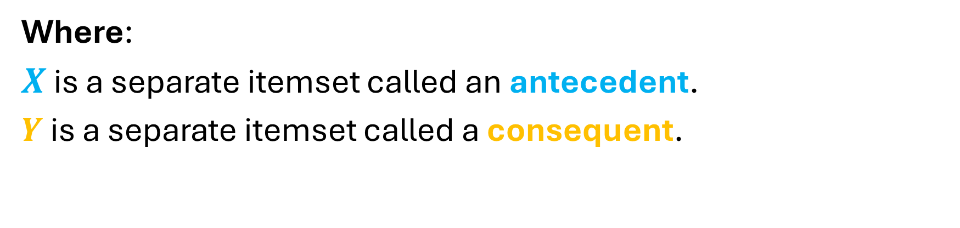

Association Rule Learning
$$X ⟹Y$$
Where:
$X$ is a separate itemset called an antecedent.
$Y$ is a separate itemset called a consequent.

Slide 5

$$bread ⟹milk$$
For example, if we have an association rule
“If a customer buys bread, he is 70% likely to buy milk”
Bread is the antecedent and milk is the consequent.

Slide 6
Association Rule Learning
All data used in this technique is categorical.
There is no dependent variable.
It input it accepts are mostly raw point-of-sale transaction data.
The output produced is the description of the most frequent relationship among variables.

Slide 7
Algorithms for generating Association Rules
Apriori
Algorithm
Eclat
Algorithm
FP-growth
Algorithm

Slide 8
Business Applications
In online retail, association rule may suggest not to put one item on sale at a time and instead to create a bundle of products promoted as a package to sell other non-selling items.

Slide 9
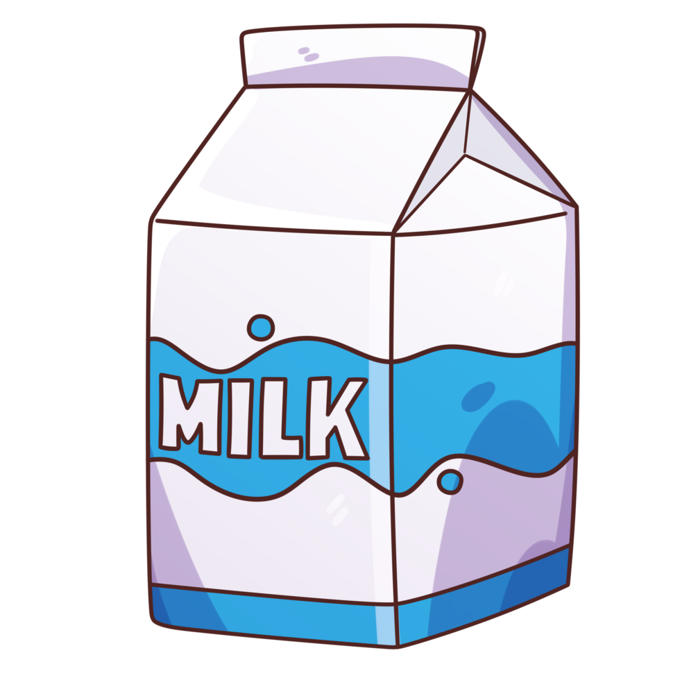



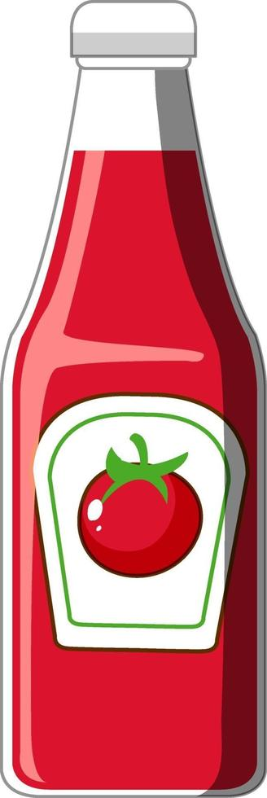

1
2
3
4
5
6
7
8
9
10
11
12

Slide 10
Transaction | Milk | Egg | Bread | Butter | Ketchup | Cookies
1 | 1 | 1 | 1 | 1 | 0 | 0
2 | 1 | 1 | 0 | 1 | 1 | 0
3 | 0 | 0 | 1 | 1 | 1 | 0
4 | 1 | 0 | 1 | 1 | 0 | 0
5 | 0 | 0 | 1 | 1 | 0 | 1
6 | 1 | 0 | 1 | 1 | 0 | 1
7 | 1 | 0 | 0 | 0 | 0 | 1
8 | 1 | 0 | 1 | 1 | 0 | 0
9 | 0 | 1 | 1 | 1 | 0 | 1
10 | 1 | 0 | 1 | 1 | 0 | 0
11 | 1 | 0 | 1 | 1 | 0 | 0
12 | 1 | 0 | 1 | 0 | 1 | 1

Slide 11
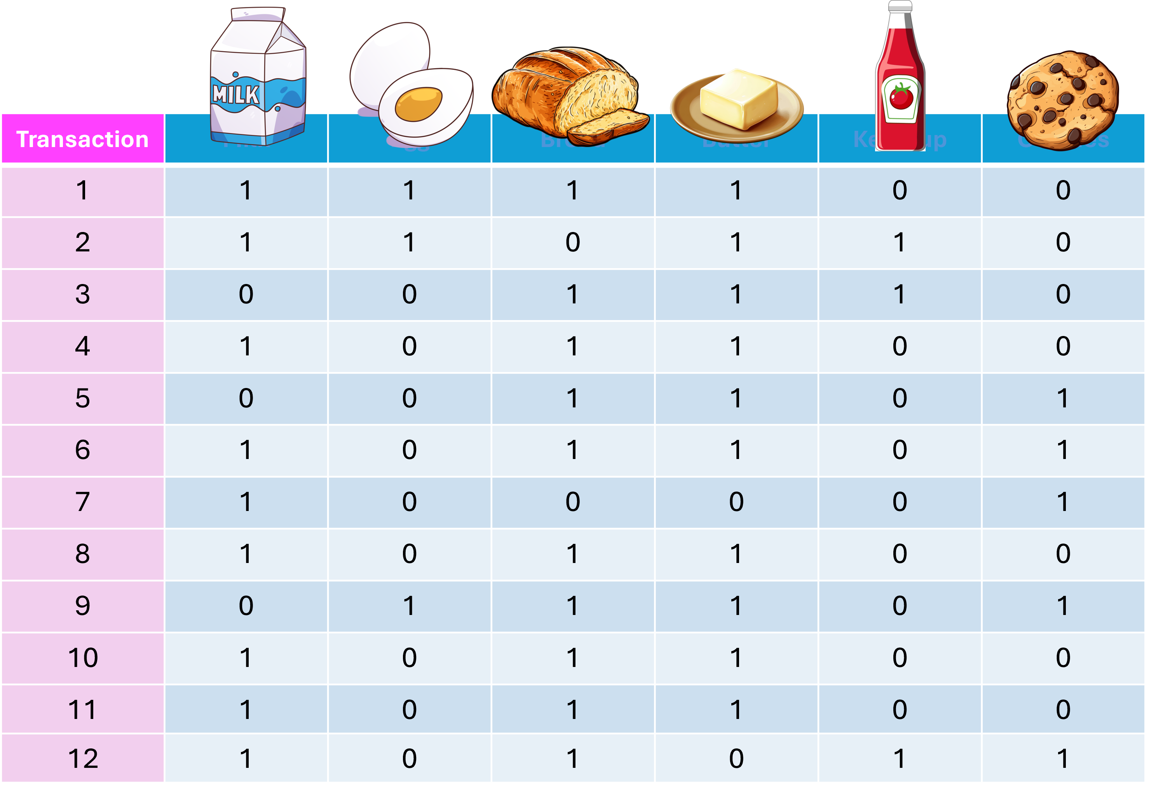
Item set | Frequency
 | 9
 | 10
 | 10
 | 3
 | 3
 | 5

Slide 12
Item set | Frequency
 | 7
 | 7
 | 3
 | 9
 | 3
 | 4

Slide 13
Item set | Frequency
 | 6
 | 1
3 | 3
 | 2

Slide 14
Support
Support is an indication of how frequently the itemset appears in the dataset.
This is an indication of how popular an item is in a dataset.

Slide 15
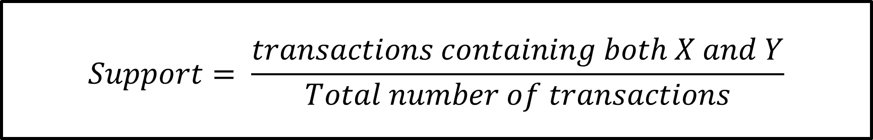
Support
$$Support= \frac{transactions containing both X and Y}{Total number of transactions}$$

Slide 16
Confidence
Confidence is an indication of how often the rule has been found to be true.
Confidence says how likely item Y is purchased when item X is purchased

Slide 17
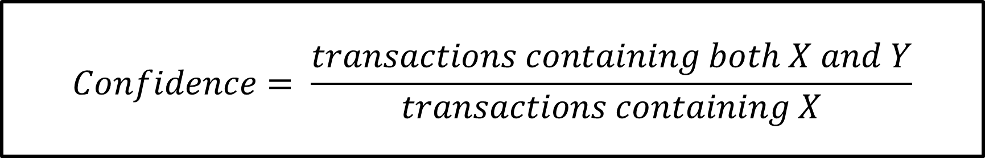
Confidence
$$Confidence= \frac{transactions containing both X and Y}{transactions containing X}$$

Slide 18

Rule | Support | Confidence
 | 50% | 66.67%
 | 50% | 60.00%
 | 50% | 60.00%
 | 50% | 85.70%
 | 50% | 85.70%
 | 50% | 66.67%

Slide 19
References

